Slide 1
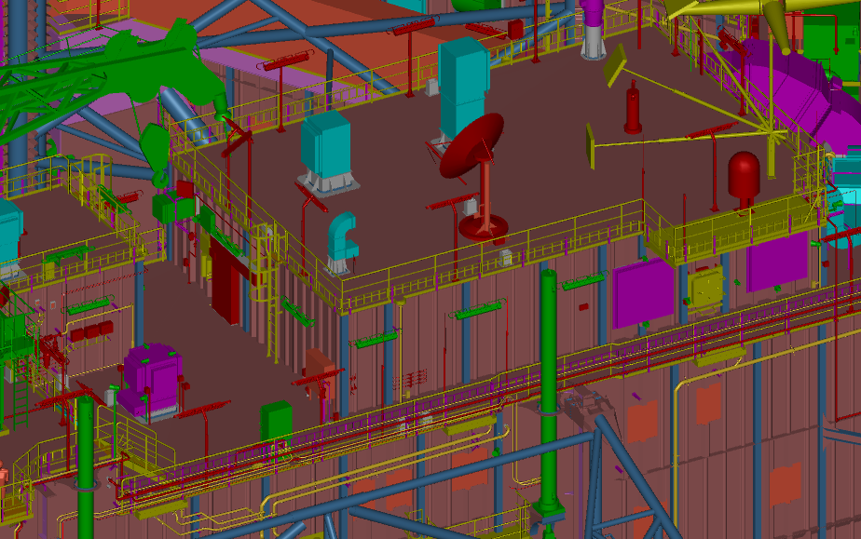
LQ/FAN ROOM TOP DECK 35100 ABL?
LADDER TO BE REPLACE WITH STAIR
DECK ‘F’ TOP 31800 ABL?
FAN ROOM TOP LOOKING FWD/INBD. STBD. SIDE

Slide 2
